Slide 1
Premises Fire Management Team Training
Last reviewed: January 2025

Slide 2
Learning Outcomes
At the end of this session staff should be able to:
Identify the duties of the Premises Fire Management Team
Identify the nature and most common causes of Fire in the workplace
Identify passive and active protection
Recognise Fire spread and combustion
Gain an understanding of the actions that must be taken in the event of a Fire
Classify different types of Fires
Gain knowledge of Fire fighting equipment

Slide 3
Fire Safety Legislation
The Fire & Rescue Services (NI) Order 2006
The Fire Safety Regulations (NI) 2010

Slide 4
Premises Fire Management Team
Appropriate Person
Premises Fire Officer
Deputy Premises Fire Officer
Evacuation Controller
Fire Wardens
Assistant for individuals with a Personal Emergency Evacuation Plan (PEEP)

Slide 5
Appropriate Person
In Fire Safety Legislation, the Appropriate Person is the person ultimately accountable for Fire Safety
This will be the employer or the person who has day to day ‘control’ of a premises. In the context of a school this will be the School Principal and in the case of other Education Authority buildings this will be the Local Senior Premises Manager
The Appropriate Person must ensure a Full Fire Risk Assessment and Annual Review of the Fire Risk Assessment (FRA) is carried out and the identified actions are implemented.

Slide 6
Appropriate Person – Completion of the Annual FRA Review
Completed by the Appropriate Person to ensure the FRA is kept up to date. The annual FRA review should take into account any significant changes from the previous FRA that may affect Fire safety.
Examples may include:
Structural changes to the layout of the building
Changes in the number of persons using the premises
Changes to the hours the premises is occupied
Fire hazards and their elimination or control
Deterioration of any of the Fire Protection measures
Management of Fire Safety
If there has been any sort of Fire incident, no matter how minor

Slide 7
Premises Fire Officer (PFO)
The PFO may manage Fire Safety on behalf of the Appropriate Person
Ensure compliance with all Fire Safety matters
Prepare and update as required, all Fire Safety Documentation (e.g. Emergency Evacuation Plan etc.)

Slide 8
Premises Fire Officer – Routine Checks
Weekly Checks e.g., testing the Fire alarm system, checking for defects & covers on detectors, opening final exit doors and ensuring escape routes are kept clear
Monthly Checks e.g., emergency lighting, extinguishers, magnetic locks & hold open devices, Fire doors
Report all defects as soon as they are observed
Carrying out Fire drills

Slide 9
Premises Fire Officer - Record Keeping
The PFO needs to keep up to date records on all Fire Safety matters in the Fire Logbook e.g.
Routine checks
Maintenance
Training and Fire Drills
Records of all Fire Safety matters are required to be readily available for inspection by the Northern Ireland Fire and Rescue Service. These records may be required as evidence following a Fire. They can be kept digitally

Slide 10
Deputy Premises Fire Officer (DPFO)
The DPFO may assist the PFO with the management of Fire Safety on behalf of the Appropriate Person
Assist the PFO to ensure compliance with all Fire Safety matters
Assist the PFO in the preparation and update of all Fire Safety Documentation (e.g. Emergency Evacuation Plan etc.)

Slide 11
Evacuation Controller
The Evacuation Controller co-ordinates the evacuation during a Fire alarm or other emergency
They should be fully aware of the Emergency Evacuation Plan
They should appoint Fire Wardens to pre-assigned locations. During an Emergency Evacuation, Fire Wardens will report the status of their area the Evacuation Controller
They ensure all Refuge Areas are checked and occupants have been brought to the Assembly Point.
They ensure all persons with a Personal Emergency Evacuation Plan (PEEP) are evacuated and the PEEP Assessment is complete and kept with the Emergency Evacuation Plan
They should be the main point of contact with the emergency services

Slide 12
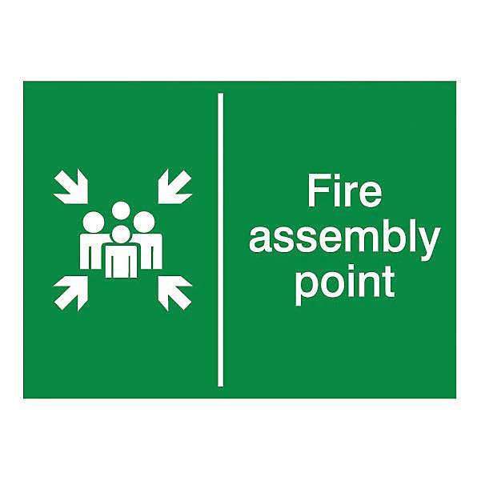
Evacuation Controller – Liaising with the Emergency Services
Has everybody left the building?
How many people are missing and/or injured?
Where is the Fire?
What is on Fire?
What hazards are there?
Are there floor plans of the building?
Means of access?
ONCE AT THE ASSEMBLY POINT THE EVACUATION CONTROLLER MUST CONFIRM THAT EVERYONE IS ACCOUNTED FOR

Slide 13
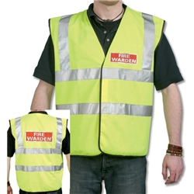
Fire Warden
Know the area you are responsible for (floor/corridor/block)
Ensure Fire Doors are kept closed
Ensure that escape routes are available for use
Identify hazards in the workplace
Ensure Smoke and Heat Detectors are not covered or missing

Slide 14
Fire Warden
Ensure a Manual Control Point (MCP) has been activated and that everyone is aware of the alarm. MCP’s are located at Fire exit doors and at changes of level in the building
Check the area for which you have responsibility is clear of all persons and all doors are closed
Ensure staff, students and visitors leave promptly
Check that anyone with a disability receives assistance
Liaise with the Evacuation Controller at the assembly point
Prevent evacuees from re-entering the building until safe

Slide 15
Fire Warden
Make yourself familiar with the risks in the building
Understand the control measures
Pass on guidance to others
Be alert to new risks being introduced
Report hazards to the PFO
Set an example and be a role model to improve the culture of Fire Safety.

Slide 16
Assistant for individuals with a PEEP
An individual who has agreed to be trained to assist with the evacuation of a person with a disability or someone requiring assistance. This may include the provision of assistance to members of the public and visitors.

Slide 17
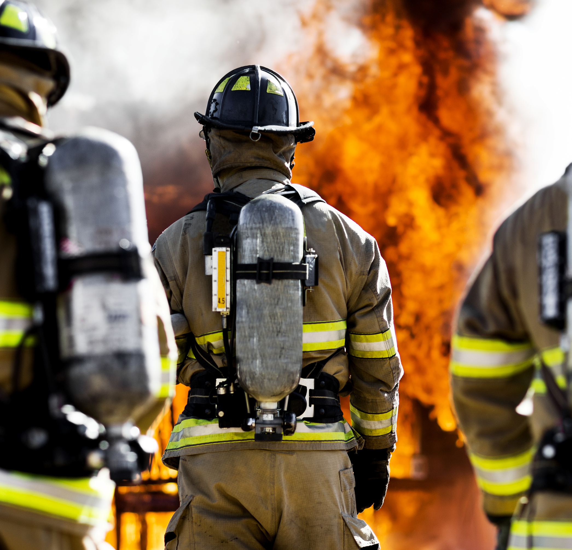
The Nature Of Fire
All Fires start small, however, can quickly become life threatening.
A typical room Fire will consume its contents within a few minutes.
Building Fires can generate temperatures in excess of 1000^{O} centigrade
In a Fire, smoke is the main killer, it is highly toxic and can be hot enough to burn your lungs.

Slide 18
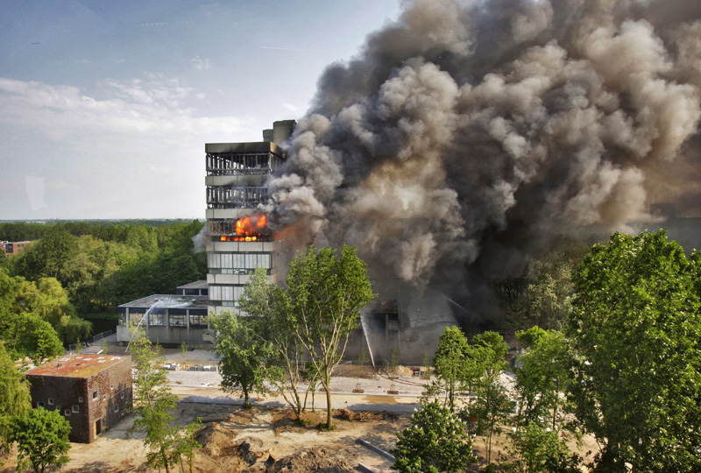
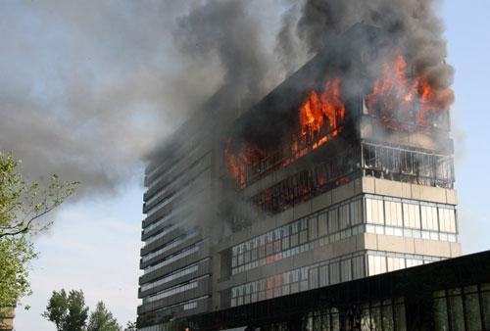
Delft Technical College
(Fire started due to electrical fault in coffee vending machine)

Slide 19
School Roof Fire
(Caused by contractors carrying out hot work in roof space)

Slide 20
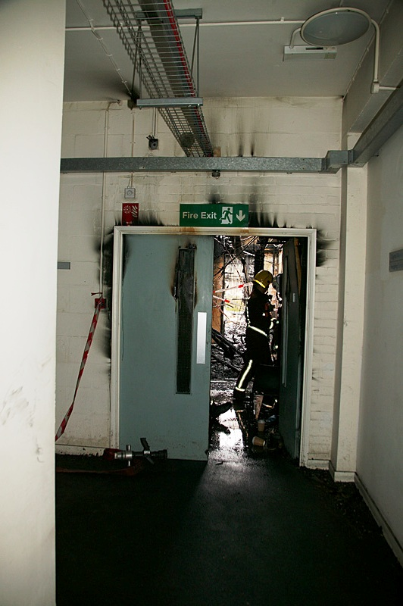
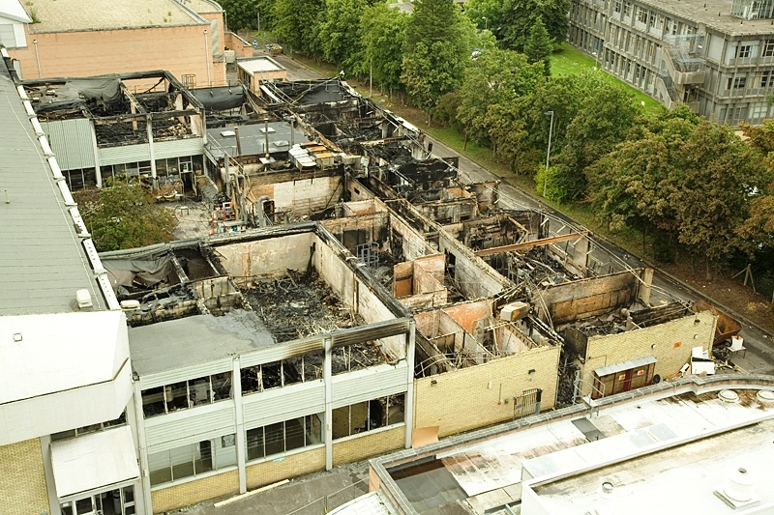
Westminster Art College
Note how effective the Fire doors were

Slide 21
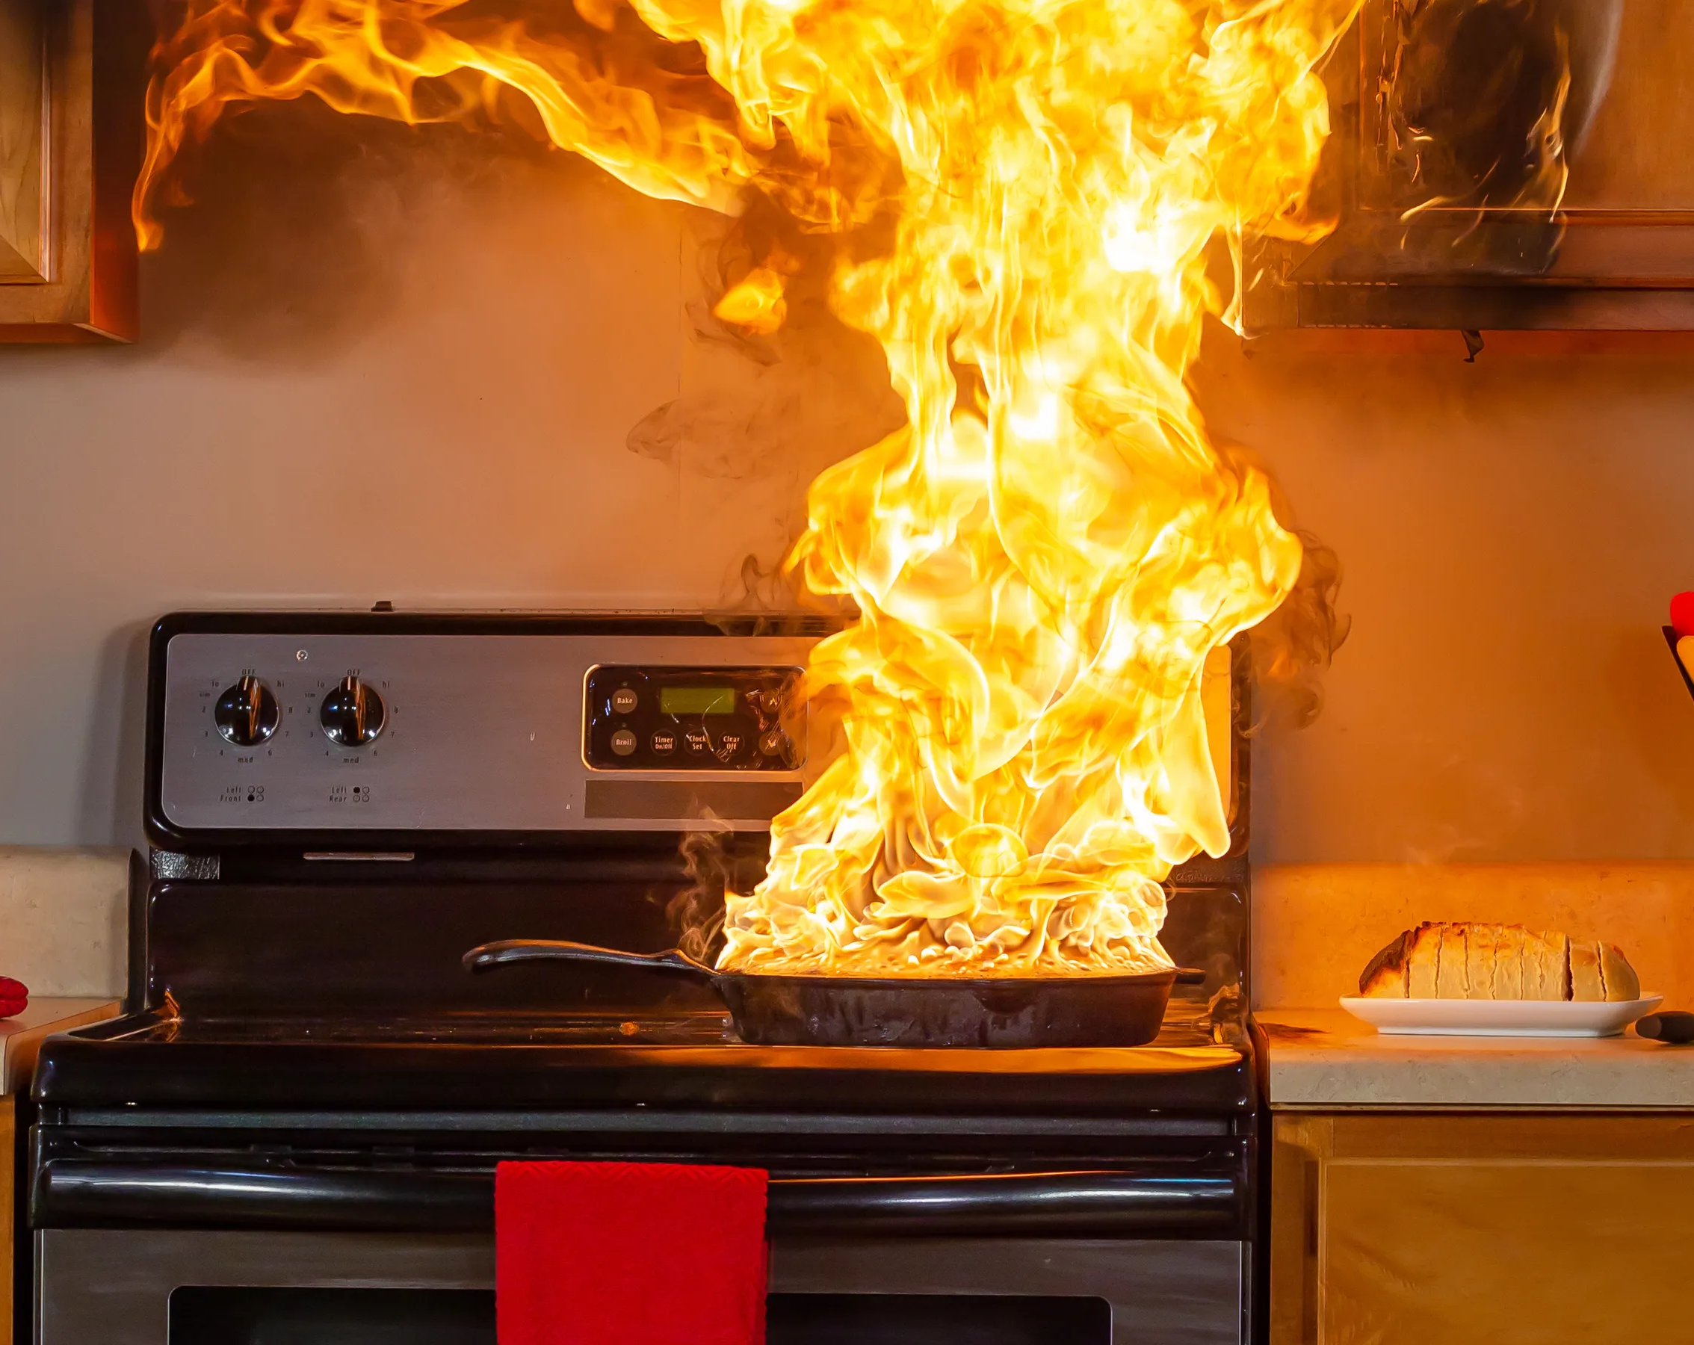
Fires Involving Cooking
Unattended cooking is one of the main causes of building Fires.
Unattended toasters cause many unwanted Fire alarms.

Slide 22
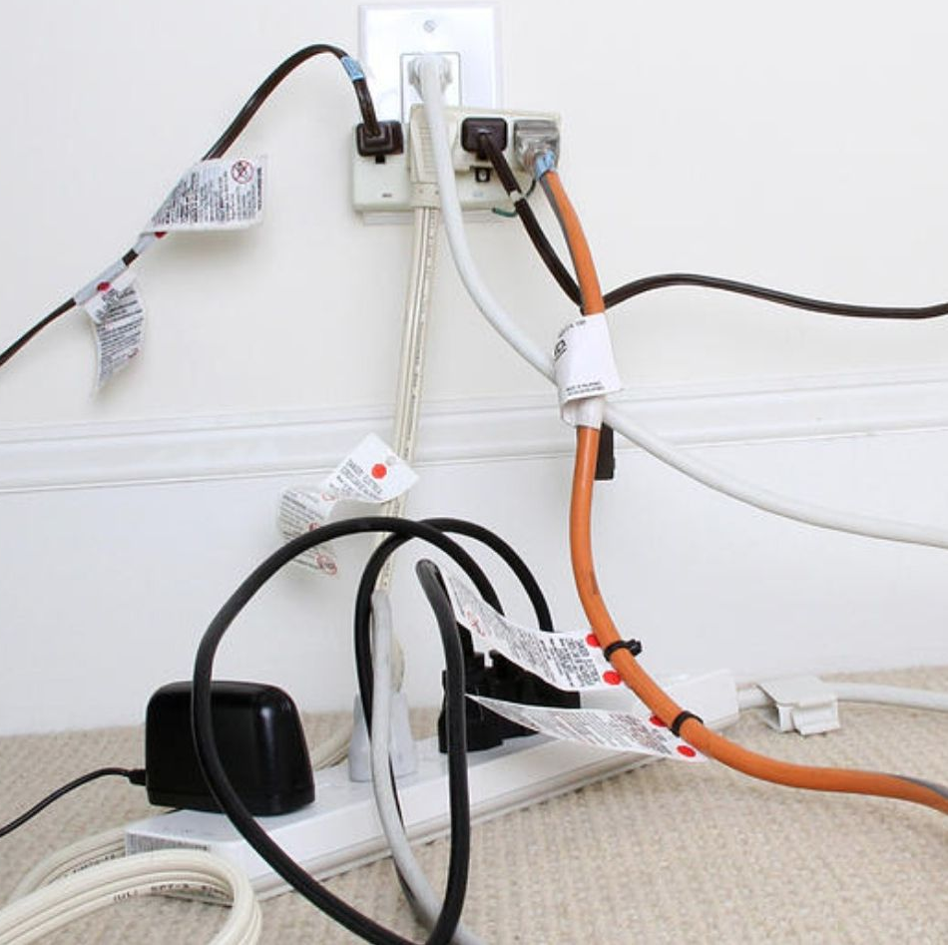
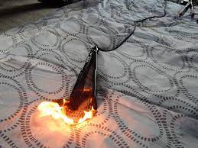
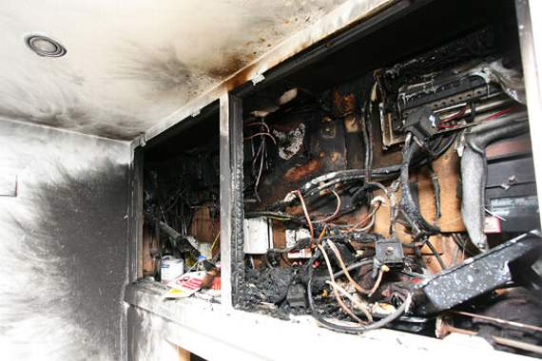
Electrical Fires
Overloaded sockets and extension leads are a common cause of Fires.
Hair Straighteners - are often left switched on unattended on soft surfaces such as duvets, leading to numerous Fires.
Electrical switchgear should always be enclosed in a Fire resistant cupboard

Slide 23
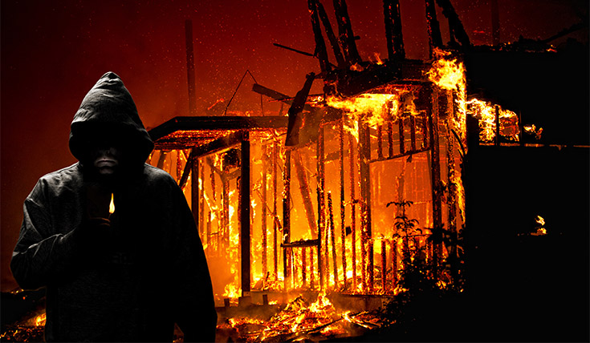
Deliberate Fire Setting
Deliberate Fire setting costs the Fire and Rescue Service up to 40% of its budget each year and over 60% of Fires in NI are started maliciously

Slide 24
Passive / Active Fire Protection
Passive Fire Protection | Active Fire Protection
Fire Doors | Automatic Fire Alarms
Cavity Barriers | Automatic Fire Shutters
Flame Retardant Paint and Varnish | Sprinkler Systems
Secure Bin Compounds | Gaseous Suppression Systems

Slide 25
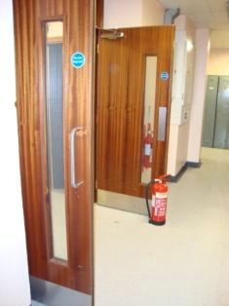
Fire Doors
Smoke inhalation is the main killer in Fires
Fire doors can be the most important protective measure. In good condition they can resist the spread of smoke and Fire for at least 30 minutes. They are a fundamental component of escape route protection.
Remember that Fire doors should never be wedged or propped open and that door closers should not be disconnected.
Wedged open/propped open/defective Fire doors put lives at risk!

Slide 26
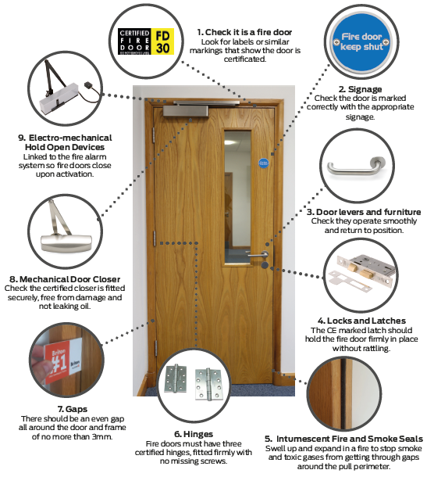
Fire Doors – The Checks
“Doors fitted with self closing devices shall be maintained self closing at all times and shall not be provided with any means of keeping them in an open position.”
“The penalty for contravening any specific regulation made under the Order, on conviction is a fine or imprisonment for not more than two years or both.”

Slide 27
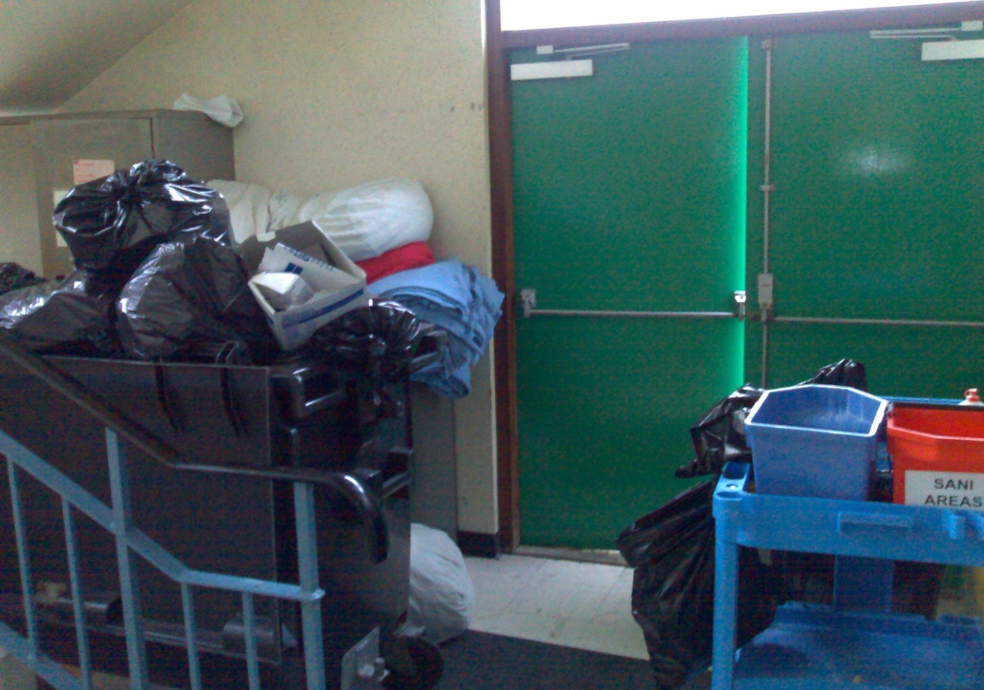
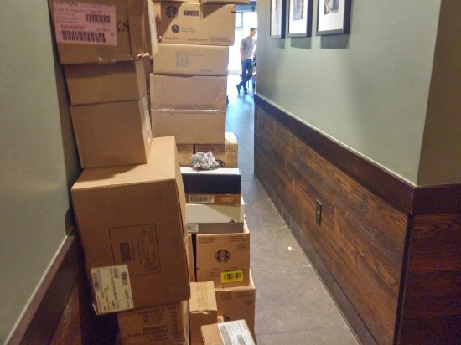
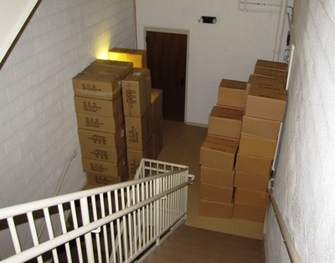
Fire Exits and Escape Routes
Do not block Fire Exits
Do not block Escape Routes
Never Reduce Escape Route Width
Fire Exits should never be obstructed or used as temporary storage, they must be kept clear at all times
Escape routes are often found to be blocked by temporary storage, which sometimes becomes permanent
If the width is reduced then there may not be enough time for everyone to escape

Slide 28
The Fire Triangle - Combustion
Fire is a chemical reaction involving three components:
Oxygen
Heat
Fuel
All three of these elements must be present at the same time for a Fire to start.
Taking steps to avoid these three elements from mixing will significantly reduce the chances of a Fire occurring.
If you remove any of these components a Fire will go out.

Slide 29
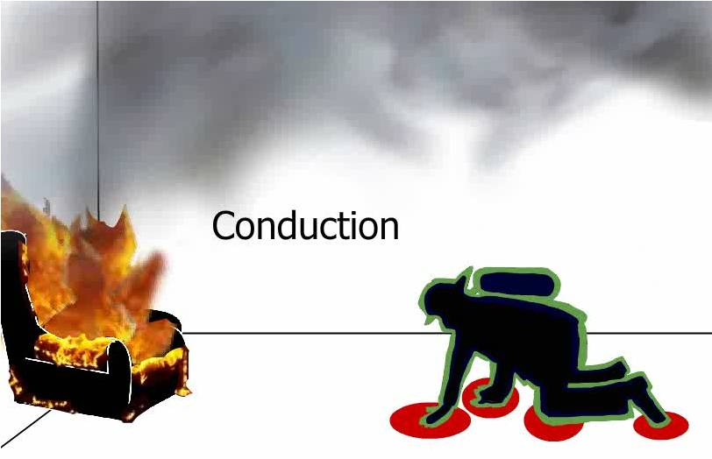
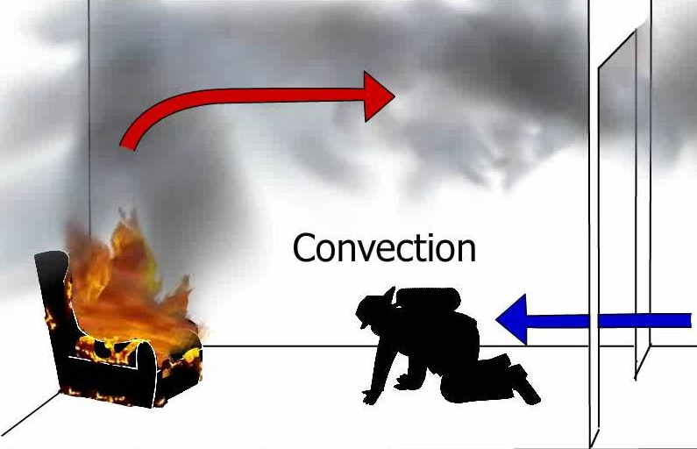
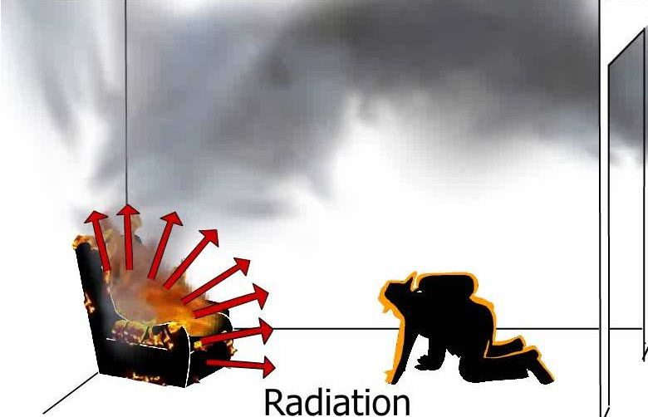
Fire Spread
Direct Radiation
Conduction Through Structural Elements
Convection Through Ambient Air

Slide 30
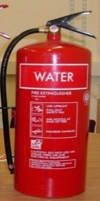
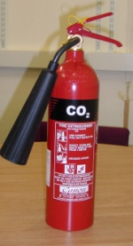
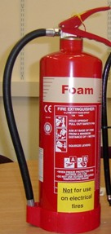
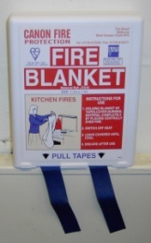
Fire Fighting Equipment
Water
CO2
Foam
Fire Blanket
Used on Fires involving paper, wood, textiles etc. Water should not be used on flammable liquids or electrical equipment.
Used on live electrical Fires and flammable liquids. CO2 may not be effective on oil or fat Fires in pans.
Used as water but can also be used on flammable liquids. Foam should not be used on electrical equipment.
Used to smother small Fires in pans or involving a person’s clothing etc.

Slide 31
Classification of Fires
Fires are given a classification depending on the type of fuel that is burning.
Once we know the classification, we can decide on the best method of extinguishing the Fire.
To extinguish a Fire, we can either:
Reduce the heat
Remove the oxygen
Remove the fuel

Slide 32
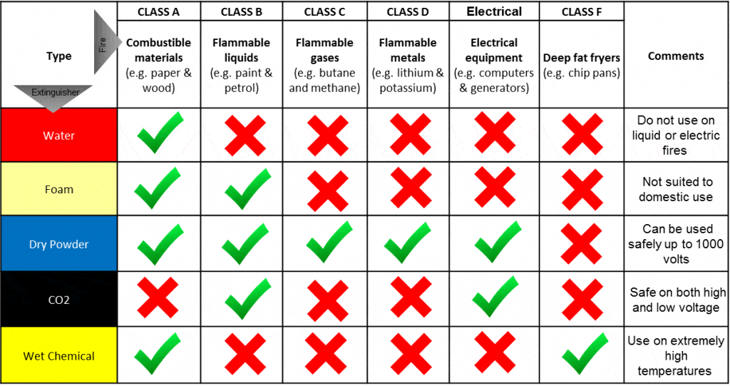
Classification of Fires

Slide 33
Useful Links
Educational-Premises.pdf (nifrs.org)
This guidance is for all employers, head teachers, governors, vice-chancellors, occupiers and owners of educational premises. The guidance informs what you have to do to comply with Fire safety law, helps you to carry out a Fire risk assessment and identify the general Fire precautions you need to have in place.
Fire-Safety-Law-Are-You-Aware-of-Your-Responsibilities.pdf (nifrs.org)
This guidance is produced by the Department of Health, Social Services and Public Safety (DHSSPS) on the new Fire safety regime. The new regime was introduced for non-domestic premises by Part III of the Fire and Rescue Services (Northern Ireland) Order 2006 and reinforced by the Fire Safety Regulations (Northern Ireland) 2010.
Fire-Safety-Law-The-Evacuation-of-Disabled-People-from-Buildings.pdf (nifrs.org)
This guidance is centred on the evacuation of people with disabilities from non-domestic premises. Persons with Fire safety obligations need to be aware that the wider aspects of Fire safety law apply equally to people with disabilities. Fire prevention or risk reduction practices and the operation of the emergency Fire action plan should all consider the effects on people with disabilities.
Offices-and-Shops.pdf (nifrs.org)
This guidance explains what a Fire Risk Assessment is and how to complete a Fire Risk Assessment for shops and offices. A Fire Risk Assessment should be the foundation for all the Fire precautions in your premises.
Sleeping-Accommodation.pdf (nifrs.org)
This guidance is for use when assessing the adequacy of Fire precautions in premises providing sleeping accommodation. The guide also provides recommendations for the Fire safety management of the premises.

Slide 34
End of Presentation
Thank you for taking the time to complete this training
Please note that in order to register as having successfully completed this training, you MUST fill out and submit the ‘Confirmation of Training Completion – Premises Fire Management Team Training Form’.
If you have any queries, please contact the QSHE - Environmental and Fire Risk Compliance Service on 028 9047 5899 or email at EAEnvironmentalCompliance@eani.org.uk

