Slide 1
Basic Legionella Awareness Training
Last reviewed: January 2025

Slide 2
Learning Outcomes
At the end of this session staff should be able to:
Identify Legislation and guidance relevant to Legionella
Recognise the health effects of Legionella
Gain an understanding of Legionella and the factors which affect it’s growth
Gain knowledge of the hot and cold water system within their premises
Recognise Legionella control, responsibilities and management
Identify the checks required to contribute to the control and management of Legionella
Gain an understanding of the records kept in the Water Hygiene Log Book

Slide 3
What is Legionella?
Legionella is a bacterium which is found naturally in fresh water such as rivers, lakes and reservoirs
Legionella can also be found in engineered hot and cold water systems, hot tubs etc. as these systems provide ideal breeding ground for bacteria
The Legionella bacteria usually enters the body by breathing in mist (aerosol) that contains the bacteria e.g. showers, kitchen spray tap etc.

Slide 4
When was Legionella First Discovered?
The first recorded discovery of Legionella was in July 1976
221 American Legion veterans became seriously unwell with a mystery illness a few days after attending a conference in Philadelphia
Following an investigation, an American Microbiologist Joseph McDade discovered the Legionella bacteria which was the cause of the veteran's mystery illness, and it was given the name Legionnaires'' Disease. The cause of the outbreak was due to a faulty humidification unit on an air handling unit
This first recorded outbreak of Legionnaires'' Disease sadly resulted in 34 deaths

Slide 5
Legionella Legislation
The following legislation is applicable to the control and management of Legionella in water systems:
The Health and Safety at Work (Northern Ireland) Order 1978
The Control of Substances Hazardous to Health Regulations COSHH 2003 (Northern Ireland)
Management of Health and Safety at Work Regulations (Northern Ireland) 2000

Slide 6
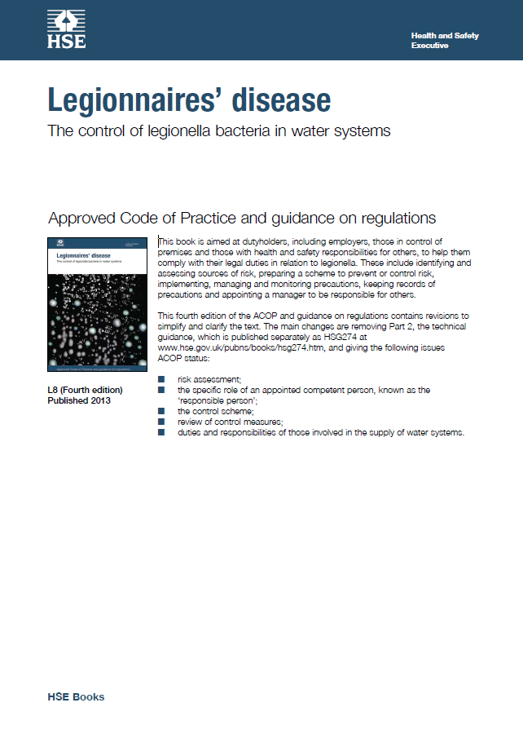
Legionella Guidance
The Approved Code of Practice (L8) is aimed at dutyholders, including employers, those in control of premises and those with health and safety responsibilities for others. L8 assists the duty holder to comply with their legal duties in relation to Legionella
HSG274 provides technical guidance on how to manage and control Legionella in water systems in the workplace

Slide 7
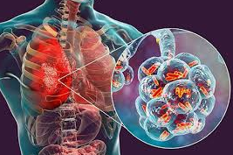
Health Effects of Legionella
There are several types of illness that Legionella bacteria can cause:
Legionnaires’ Disease
Is a serious illness which has an incubation period between 2 to 19 days following exposure
It is an acute bacterial pneumonia
It is treatable with antibiotics but could be a slow recovery
Approximately 300-500+ cases each year in the UK, mortality rate of 12%
Lochgoilhead & Pontiac Fever
Is a less serious disease for most people
Incubation period would be between 2 to 3 days

Slide 8
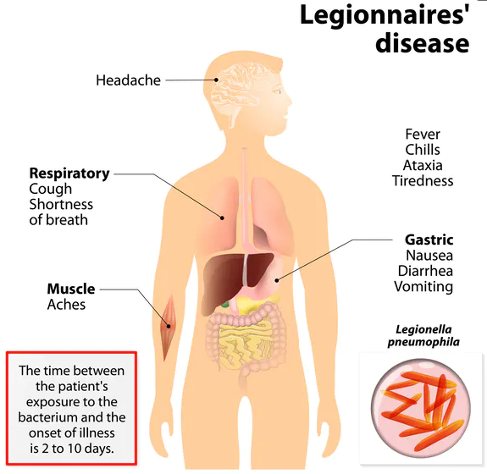
Symptoms of Legionnaires’ Disease
Legionnaires’ Disease is also known as Legionellosis. Signs and symptoms include cough, shortness of breath, high fever, muscle pains, and headaches. Nausea, diarrhoea and vomiting may also occur
Risk factors for infection include older age, a history of smoking, chronic lung disease, and poor immune function

Slide 9
Long Term Effects of Legionnaires’ Disease
This diagram outlines possible long-term effects
Legionnaires’ Disease, if caught early and treated correctly, can be fully cured
Full recovery can take up to a year and sometimes longer depending on the severity
Concentration problems and confusion
Long- and short-term memory loss
Fatigue and shortness of breath
Neuromuscular symptoms; joint pain and muscle weakness
Potential onset of asthma

Slide 10
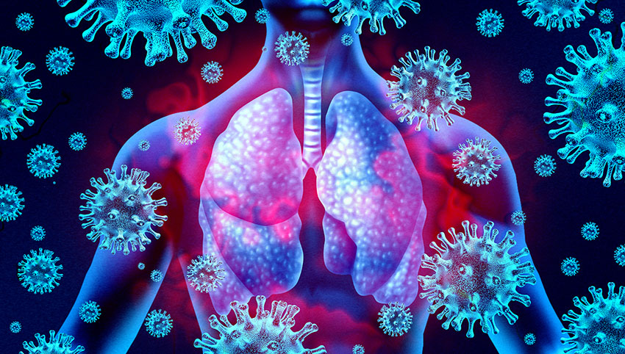
Susceptibility
Susceptibility is defined as being at greater risk of contracting Legionnaires’ diseases.
The following can contribute to increased susceptibility:
Smoking
Alcoholism
Diabetes
Respiratory Disease
Cancer
Kidney Disease
Over 40’s
Men (3 times more likely to contract than females)

Slide 11
The Legionella Causative Chain
The Causative Chain is the sequence of conditions which results in the growth, transmission and exposure to Legionella
Presence of Legionella
Legionella bacteria present in the water source
Multiplication
Legionella is allowed to grow because of:
- A food source
- Stagnation
- Poor temperatures
Transmission
The contaminated water can be spread by an aerosol (water droplets) from a shower etc.
Exposure
A person coming into contact with the contaminated aerosol
Susceptibility
The person exposed being susceptible to infection

Slide 12
What does Legionella need to survive?
Nutrients - food source e.g., scale, sediment and corrosion
Temperature - between 20-45°C is ideal for growth and reproduction
Protective Environment - bio-films (slimy texture on cold water storage tank wall) are the bacteria’s preferred habitat to grow in
Oxygen - whilst not essential for growth, increased oxygen will promote growth in e.g., Jacuzzi’s and water features
Stagnation - when water ceases to flow e.g., oversized water systems and water systems left idle (unused water taps)

Slide 13
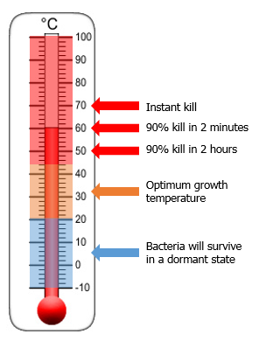
The Affect of Temperatures on Legionella Growth
All organisms have their favoured temperature range and Legionella is no exception. The optimum temperature that Legionella thrives is 37°C which is human body temperature
The following provides information about the effect of water temperature on the survival of Legionella in water systems;
Below 20°C Legionella should remain dormant
20°C to 45°C is ideal for growth and reproduction
50°C to 60°C, 90% of Legionella will die within 2 hours
60°C to 70°C, 90% of Legionella die within 2 minutes
Above 70°C Legionella is instantly killed

Slide 14
Please take the time to identify which of the following is applicable to your premises

Slide 15
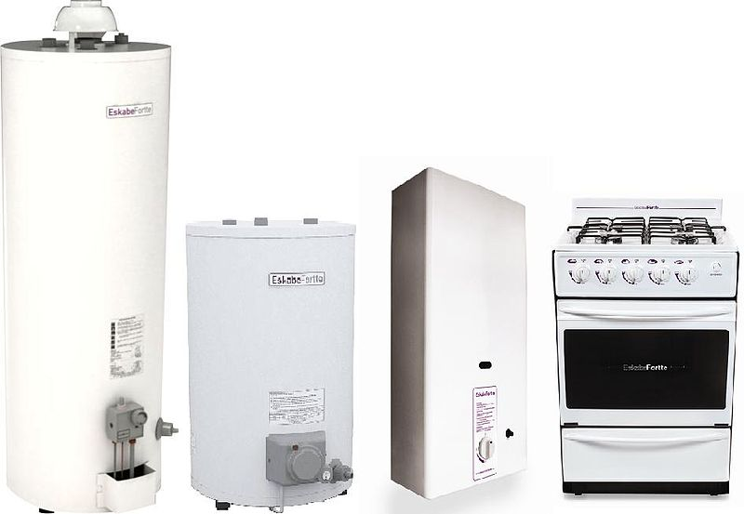
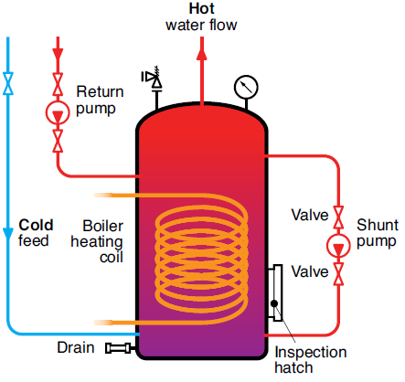
Calorifier (CAL)
A CAL is a vessel that is normally supplied by mains water or a cold-water storage tank which delivers hot water to taps and showers on the premises
Hot water should be stored at 60°C
If present, return temperature must achieve 50°C
Achieve 50°C at hot water outlet within 1 minute
Insulated vessel and pipework
Pipework labelled with flow direction
Drain at the base of unit

Slide 16
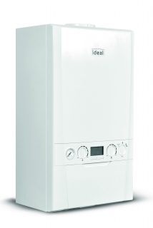
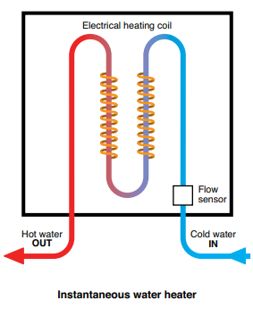
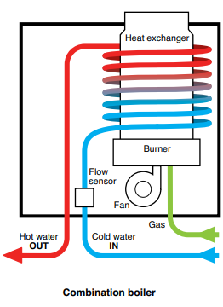
Instantaneous Water Heater (IWH)
An IWH is a unit that is normally supplied by mains water or a cold-water storage tank which delivers hot water to outlets on the premises
IWH’s provide hot water directly from the cold-water supply by heating the water as it passes through the heater

Slide 17
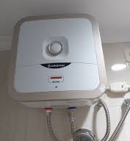
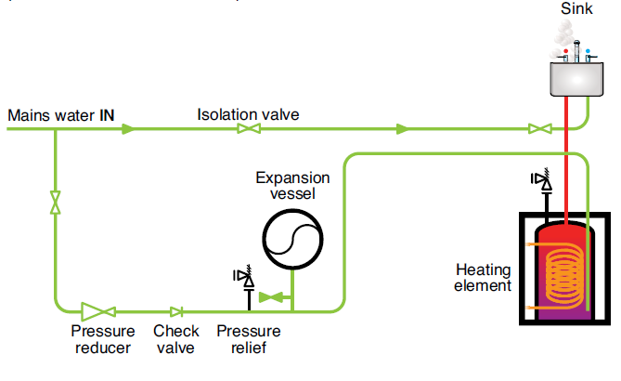
Point of Use (POU) Water Heater
A POU water heater is a unit that is normally supplied by mains water or a cold-water storage tank which delivers hot water to outlets on the premises
To assist in the control of Legionella, a POU water heater should store water at 50-60°C and be able to achieve 50°C at outlet within 1 minute

Slide 18
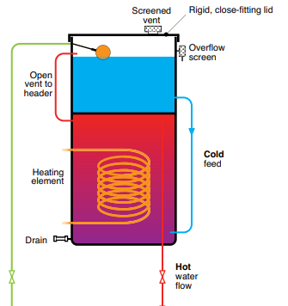
Combination Water Heater (CWH)
A CWH is a unit that is normally supplied by mains water or a cold-water storage tank which delivers hot water to outlets. CWH’s store a volume of cold water (ranging from 10–200 litres) above the hot water storage unit
To assist in the control of Legionella, CWH should store water at 50-60°C and be able to achieve 50°C at outlets within 1 minute
The combination water unit requires the following:
A close fitting lid
Lid vent
Screened overflow pipe

Slide 19
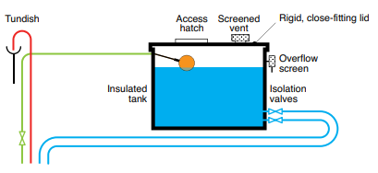
Cold Water Storage Tank (CWST)
A CWST is normally supplied by mains water and delivers cold water to all outlets including, taps, toilets, urinals, calorifiers and water heaters on the premises. A compliant CWST will have the following:
A close-fitting lid, lid vent, rodent and insect screen
Be well insulated including lids and pipework
12 hours stored water supply, stored below 20°C
Ball valve opposite to outlet
Pipework labelled with flow direction
No hot water vent pipe discharge

Slide 20
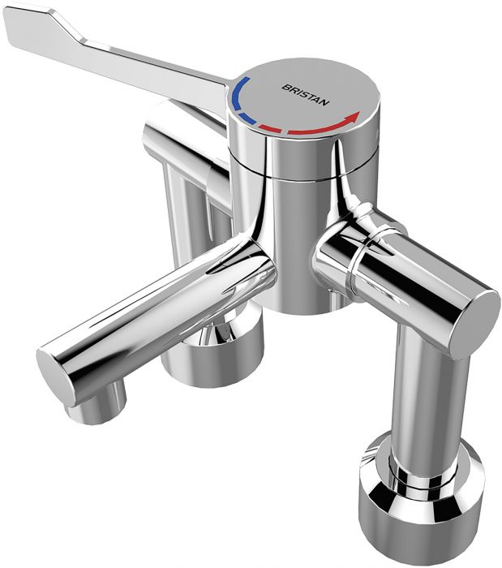
Thermostatic Mixing Valves (TMV) & Thermostatic Mixing Taps (TMT)
TMV & TMT blend cold and hot water at taps and showers to ensure water is delivered to the end user at a safe temperature

Slide 21
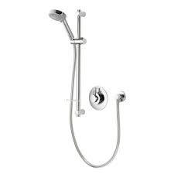
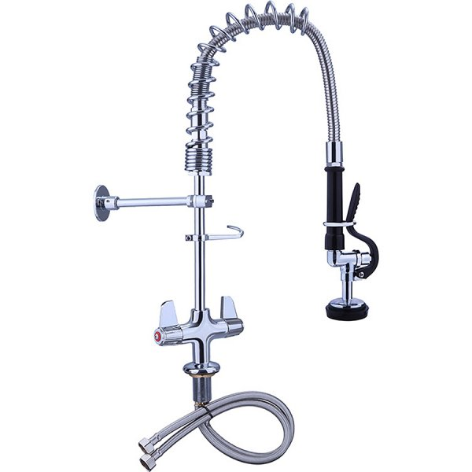
Shower and Kitchen Spray Outlets
Showers and kitchen spray outlets both create significant aerosols when in operation

Slide 22
Roles and Responsibilities
Duty Holder: As an employer or person in control of premises, you must put in place suitable precautions to prevent or control the risk of exposure to Legionella.
Responsible/Competent Person: Appointed by the Duty Holder to take responsibility for managing the risk associated with Legionella. You will provide suitable and sufficient information, instruction, and training to the nominated person
Nominated Person: You will ensure the completion of statutory weekly and monthly tasks and the maintenance of the Water Hygiene Logbook

Slide 23
Statutory Tasks
There are numerous statutory tasks which must be completed by the nominated person to assist in the control and prevention of Legionella. These tasks include:
Weekly Checks - Flushing of infrequently used outlets
Monthly Checks – Sentinel outlets and temperatures
Keeping an up-to-date Water Hygiene Logbook
EA will provide suitable information, instruction and training to all nominated persons

Slide 24
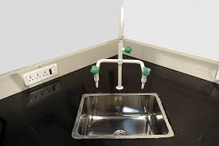
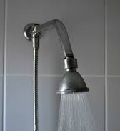
Weekly Checks - Infrequently Used Outlets (IUO)
IUO are those which are not used on a weekly basis
If the water contained in the pipework lies static for a period of one week or more, Legionella may grow
It is vital that the IUO are flushed once a week. The flushing regime and temperature checks should be recorded in the Water Hygiene Logbook

Slide 25
Monthly Checks - Sentinel Outlets and Temperatures
Sentinel Outlets are taps which are used to monitor water quality and temperatures
They are defined as the first and last outlets on the water system
Cold Water
This will be the water outlets nearest to and furthest from the cold water storage tank or incoming mains. Temperature should be below 20°C within 2 minutes of drawing off from the cold water outlet
Hot Water
This will be the water outlets nearest to and furthest from the hot water source i.e. calorifier/water heater etc. Temperature should be a minimum of 50°C within 1 minute of drawing off water from the hot water outlet

Slide 26
Quarterly Checks
EA has a robust programme of statutory quarterly Legionella monitoring in place, that is delivered via a team of specialist contractors
Quarterly tasks include:
Cold Water Storage Tank inspections
Water sampling
Temperature checks
Dismantle, clean and descale shower heads

Slide 27
Water Hygiene Logbook
All tasks carried out on site must be recorded, and kept for 5 years, in the Water Hygiene Logbook. An up-to-date Water Hygiene Logbook will:
Ensure that all weekly and monthly tasks are carried out and recorded
Ensure compliance with legislation and guidance
Provide documentation for reporting and auditing purposes

Slide 28
Table of Weekly & Monthly Checks
Outlet | Checks to be completed | Frequency | Action by
Infrequently Used Outlets (IUO) | Tap and showers to be flushed thoroughly | Weekly | School
Calorifier Flow | Check calorifier flow temperatures to ensure the flow is 60 °C | Monthly | School
Calorifier Return | Check calorifier return temperatures to ensure the return is 50 °C | Monthly | School
Hot and Cold Sentinel Outlets | Check temperatures at sentinel taps | Monthly | School
Combination Water Heater | Check water temperatures at an outlet to confirm the heater operates at 50-60 °C
Point of Use Water Heater | Check water temperatures to confirm the heater operates at 50-60 °C or check the installation has a high turnover

Slide 29
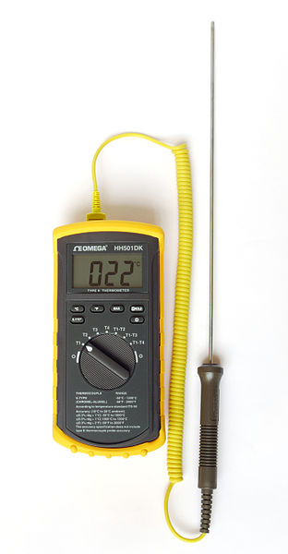
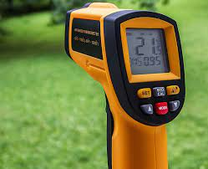
Use of Thermometers for Monthly Temperature Checks
Thermometers are used for measuring the temperature of hot and cold-water outlets, these could be a probe, or an infrared unit as seen in the images
When the nominated person has completed their onsite training, they will be provided with a thermometer
The nominated person is responsible for ensuring that the thermometers are calibrated as per manufacturer’s guidelines
Probe Thermometer
Infrared Thermometer

Slide 30
Useful Links
The ACoP (L8) is aimed at dutyholders, including employers, those in control of premises and those with health and safety responsibilities for others, it is to help them comply with their legal duties in relation to Legionella
HSG274: Part 2 provides technical guidance on how to manage and control Legionella in water systems in the workplace
The Health and Safety at Work (NI) Order 1978
The Control of Substances Hazardous to Health Regulations COSHH 2003 (NI),
Management of Health and Safety at Work Regulations 2000 (NI),

Slide 31
End of Presentation
Thank you for taking the time to complete this training
Please note that in order to register as having successfully completed this training, you MUST fill out and submit the ‘Confirmation of Training Completion – Basic Legionella Awareness Training Form’.
If you have any queries, please contact the QSHE - Environmental and Fire Risk Compliance Service on 028 9047 5899 or email at EAEnvironmentalCompliance@eani.org.uk

