Slide 1
Basic Fire Safety Awareness Training
Last reviewed: January 2025

Slide 2
Learning Outcomes
At the end of this session staff should be able to:
Identify the components needed for a fire to start
Identify the most common causes of fire in the workplace
Outline the main consequences of fire in the workplace
Identify ways you can contribute to fire prevention and protection
Identify the structural features of a safe escape and how to ensure that they are maintained and available
Gain an understanding of the actions that must be taken in the event of a fire
Gain knowledge of fire fighting equipment

Slide 3
Introduction
The Fire Service (Northern Ireland) Order came into effect in 2006 & the Fire Safety Regulations (Northern Ireland) came into effect in 2010.
Education Authority (EA) has a statutory obligation to provide all employees with this training. This training will help minimise the risk of fire and protect staff from harm.
Health and Safety at Work (NI) Order 1978
Management of Health and Safety at Work Regulations (NI) 2000
Every year there are approximately 650 workplace fires in Northern Ireland. Many of these fires could have been avoided if fire hazards were properly controlled.

Slide 4
Fires develop with frightening speed!

Slide 5
The Fire Triangle
Fire is a chemical reaction involving three components:
Oxygen
Heat
Fuel
All three of these elements must be present at the same time for a fire to start.
Taking steps to avoid these three elements from mixing will significantly reduce the chances of a fire occurring.
If you remove any of these components a fire will go out.

Slide 6
Breaking the Fire Triangle
Remove the Oxygen
Remove the Heat
Remove the Fuel
Oxygen is required for a fire to burn. Oxygen is all around us.
In order to remove the oxygen:
Cover with foam or a fire blanket
Use a CO₂ Extinguisher.
Removing the ignition source - flames, electrical sparks etc. can help to put a fire out.
Fuel is anything that will burn - most things that you will find at work.
Remove combustibles from the area of the fire or turn off gas.

Slide 7
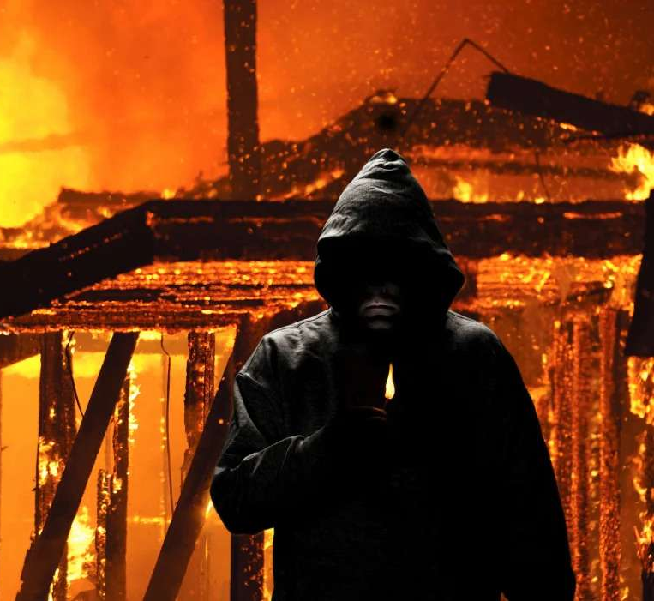
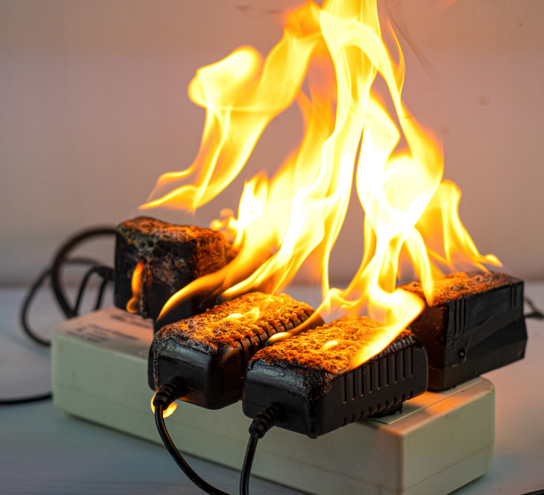
Common Causes of Fire at Work
Arson
Smoking
Kitchen Fires
Electrical Faults
66% of fires in Northern Ireland are classified as malicious.
Make sure buildings are secure when you leave
Keep bins away from buildings
Report suspicious activity
Smoking related fires are on the decline.
At work, you must only smoke in designated smoking areas and never inside any EA buildings.
When cooking, never leave appliances unattended. This includes toasters.
Due to:
Overloaded sockets
Misuse of adaptors
Faulty wiring / frayed cables
Misuse of extension leads
Damaged plugs
Incorrect fuses
Overheating

Slide 8
Human Behaviour
Human behaviour is a common reason why workplace fires start. This may be through negligent actions, carelessness, ignorance and vandalism.
Negligent actions such as stacking combustible materials on heated equipment.
Reckless behaviour during a fire evacuation:
Using a familiar route even though it is not the fastest nor the safest.
Reacting slowly or not at all. Perhaps assuming a fire alarm is a fault or drill.
Instinctively, looking to others to take the lead.
2 ½ minutes is the accepted time to evacuate an entire building of its occupants
YOU NEED TO ACT QUICKLY AND SAFELY IN THE EVENT OF A FIRE!

Slide 9
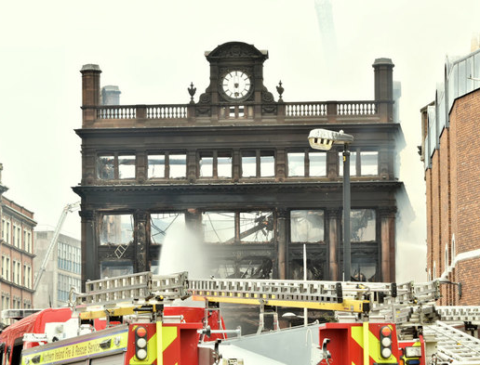
Consequences of Fire at Work
Fire can cause:
Death or serious injury either by smoke inhalation or through burns
Physical and mental trauma to employees
Expensive damage to buildings
£100m cost to Primark in wake of 2018 store fire in Belfast.
Damage to the environment.

Slide 10
Grenfell Tower Fire
Grenfell Tower timeline of events
On 14 June 2017 fire broke out in the kitchen of a flat on the 4th floor of the Grenfell Tower block in London.
The fire was started by an electrical fault in a fridge freezer.
The exterior cladding was wrongly specified and had a flammable core, the regulations for this application specify non-combustible.
The fire caused 72 deaths, many injuries and left hundreds homeless.

Slide 11
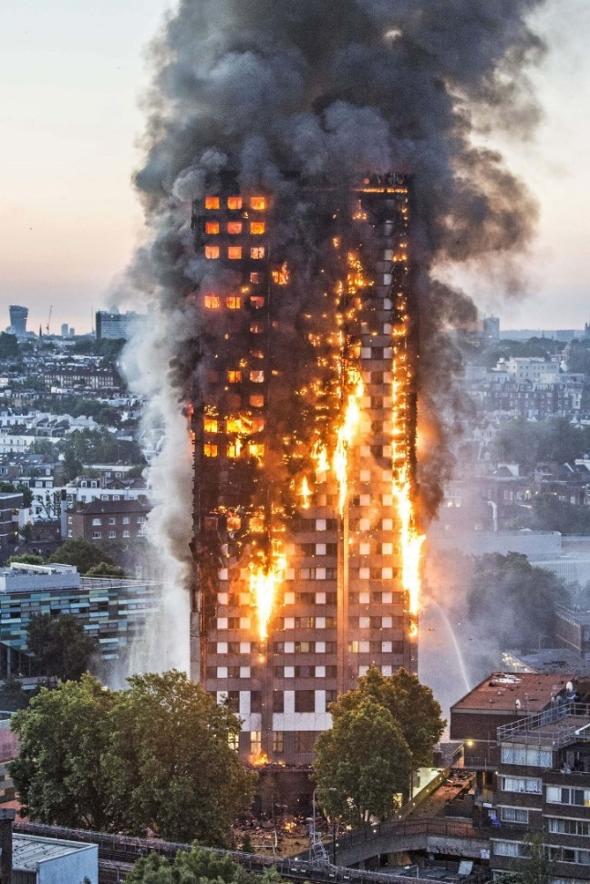
Grenfell Tower Fire – What went wrong?
High priority recommendations from the fire risk assessment were not implemented
The refurbished exterior design didn’t comply with Building Regulations
Maintenance work carried out over decades had compromised fire compartment separation
Consequently the ‘Stay Put’ policy failed
What is a ‘Stay Put’ policy?
A ‘Stay Put’ Policy is used in high rise and some low rise residential buildings. Buildings are sub-divided into fire protected compartments (individual apartments and floors). If there’s a fire in the building it’s safe to stay within the compartment for a specified time, while the Fire and Rescue Service deal with the situation.
All 24 floors affected by the fire

Slide 12
Fire Prevention
Control measures that prevent a fire from occurring.
Maintain good housekeeping & do not wedge open fire doors
Visual checks of electrical equipment - if you notice any damage, do not use. Mark it unsafe and report!
Safe use of portable heaters - do not place anything on top of a heater or place it near a fuel source
Safe smoking practices (if a smoker)
Vigilance towards the risk of deliberate firesetting
Reporting unsafe behaviour and potential fire hazards
Undertake training
Comply with measures in the Fire Risk Assessment
Keep ignition sources away from combustible material or flammable liquids and gases
Keep flammable liquids to a minimum and close containers when not in use

Slide 13
Fire Protection
Control measures that will save lives and minimise structural damage in the event of a fire.
Carry out and regularly review the Fire Risk Assessment
Be familiar with emergency arrangements
Be familiar with your means of escape
Maintain fire door integrity
Follow good housekeeping practices
Be familiar with the location of fire safety items
Make your whereabouts known
If you are unsure about any of the above, please discuss it with your line manager or contact the QSHE - Environmental and Fire Risk Compliance Service on 028 9047 5899 or email at EAEnvironmentalCompliance@eani.org.uk

Slide 14
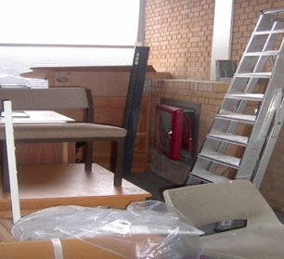
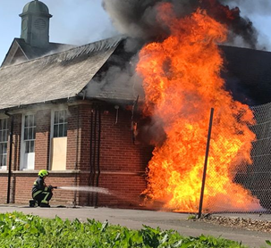
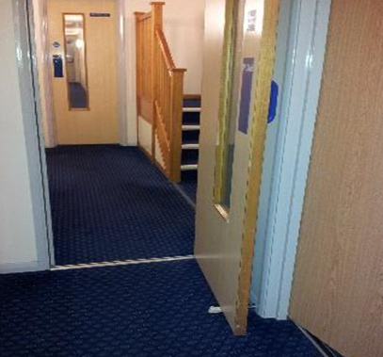
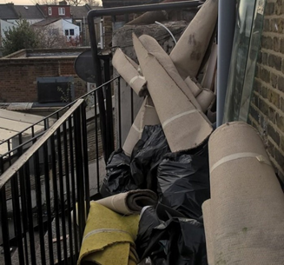
Typical Fire Safety Problems
Poor Storage
Bin Fires
Wedged Fire Doors
Blocked Fire Escapes
Combustible material and ignition sources should not block escape routes.
Bin fires can spread into structures quickly and should be stored securely away from buildings.
Wedging fire doors open allows smoke and fire to enter escape routes. A wedged fire door is not a fire door!
External fire escape stairs must be kept clear of obstructions and their structural integrity should be checked annually.

Slide 15
Fire Door Integrity
FIRE DOORS ARE CRITICAL FOR SAFETY
Fire Doors are:
Designed to stop the spread of smoke, heat and flames for at least 30 minutes to allow a safe exit in the event of a fire.
Placed on higher risk rooms (kitchens, switch rooms etc.) and within corridors to shorten and protect the route to a safe area, providing an escape route free from smoke.
Often fitted with self closing or hold-open devices to ensure that doors are in the correct position.
One of the most important fire protection provisions - they help prevent fire and smoke from spreading.
Only effective if they can close!
You must play your part in ensuring that fire doors are kept shut at all times.
Wedging fire doors open is illegal, unsafe and against EA policy.

Slide 16
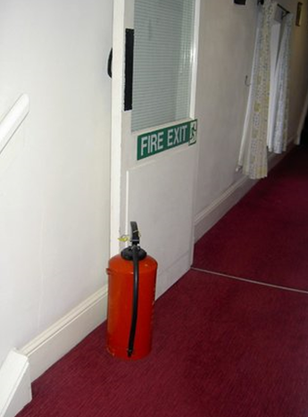
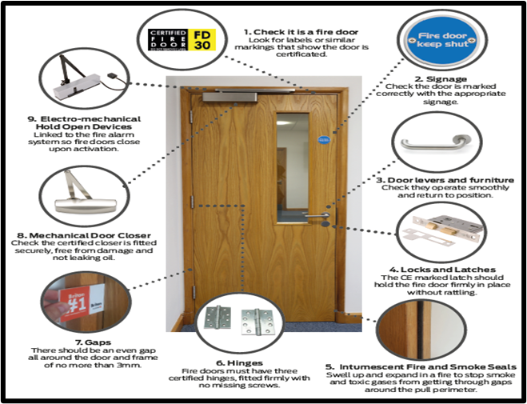
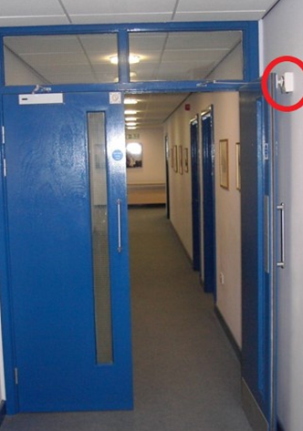
Fire Door Integrity
Stop the Spread
Good Condition
Door Release Device
Doors should not be propped open with bags, wedges, fire extinguishers etc.
Doors can be held open by a door release mechanism linked to the fire alarm system.

Slide 17
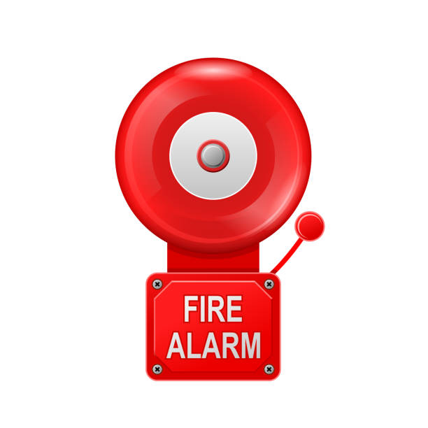
Fire Safety Management – The Fire Alarm
The weekly fire alarm test is essential:
To ensure the system is functional
To ensure people know what it sounds like
To comply with legislation
Testing must be recorded in the fire safety log book for inspection by the Fire & Rescue Service. The Fire Safety Log Book should contain records of:
Weekly Fire Alarm test
Monthly Emergency Lighting test
Fire Safety training
Fire Evacuation drills
False Alarms
Where a fire alarm is also used to signal class changes, people must clearly understand the difference.
A continuous sound means evacuate immediately.

Slide 18
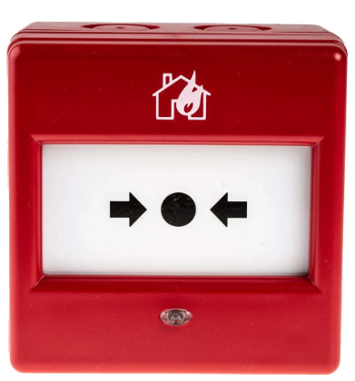
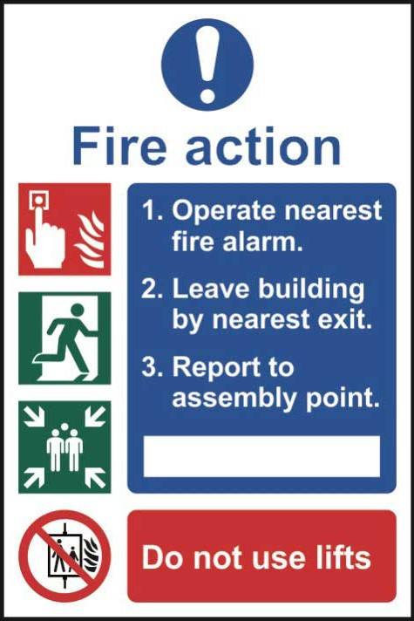
Fire Safety Management – Manual Call Point
If there is no automatic fire detection staff must understand the purpose and use of manual call points.
Purpose of a Manual Call Point:
Allows for the manual activation of the fire alarm system in the event of an emergency
How to use:
Break the plastic and press the button to activate the fire alarm system
A manual call point
This notice should be located beside manual call points

Slide 19
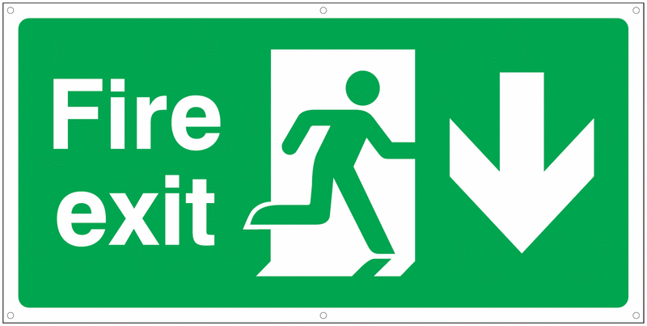
Fire Safety Management – Safe Escapes
Don’t obstruct escape routes or exits
Familiarise yourself with the:
Location of fire exits throughout the building you are working within
Make sure you know where your Assembly Point is
Location of important fire safety items (fire blankets etc.)
Fire exits must be checked daily when opening and locking the building to ensure that:
They can be reached easily
They can be opened easily
There are no obstructions inside or outside
IF YOU ARE UNSURE OF ANY OF THE ABOVE, SPEAK TO YOUR LINE MANAGER IMMEDIATELY

Slide 20
Fire Safety Management – Emergency Lights
Emergency lights will help to guide people from the building and indicate exits in the event of a power failure.
Emergency lights are checked periodically however, should you notice a fault, please log a call on the maintenance helpdesk.

Slide 21
If you discover a fire
Fire Essentials
Sound the alarm by breaking the nearest manual call point.
Call 999 and request the Fire Service.
Staff are to evacuate the premises, closing doors behind them and assist disabled users to evacuate the building.
Do not try to use lifts
If you are a Fire Warden, carry out any assigned duties, otherwise go straight to the assembly point, don’t delay to collect belongings
Only tackle a fire if you have been trained and it is safe to do so.
GET OUT and STAY OUT and await the arrival of the Fire Service.
Complete a staff roll call.
The responsible person (this should be a member of the Premises Fire Safety Management Team) is to brief the Fire Service on arrival.

Slide 22
Fire Essentials
If you hear the fire alarm
Evacuate the premises, closing doors behind you and assist disabled users to evacuate the building.
Do not try to use lifts
If you are a Fire Warden, carry out any assigned duties, otherwise go straight to the assembly point, don’t delay to collect belongings
Only tackle a fire if you have been trained and it is safe to do so.
GET OUT and STAY OUT and await the arrival of the Fire Service.
Complete a staff roll call.
The responsible person (this should be a member of the Premises Fire Safety Management Team) is to brief the Fire Service on arrival.

Slide 23
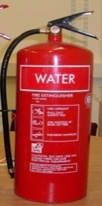
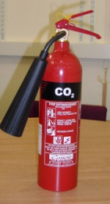
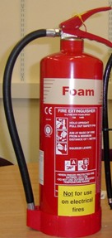
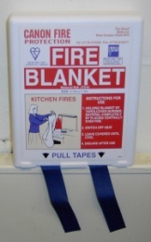
Fire Fighting Equipment
Water
CO2
Foam
Fire Blanket
Used on fires involving paper, wood, textiles etc. Water should not be used on flammable liquids or electrical equipment.
Used on live electrical fires and flammable liquids. CO2 may not be effective on oil or fat fires in pans.
Used as water but can also be used on flammable liquids. Foam should not be used on electrical equipment.
Used to smother small fires in pans or involving a person’s clothing etc.

Slide 24
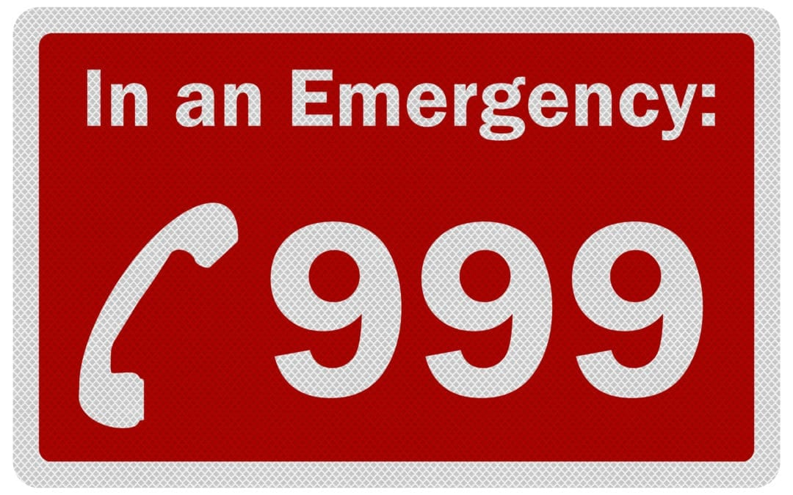
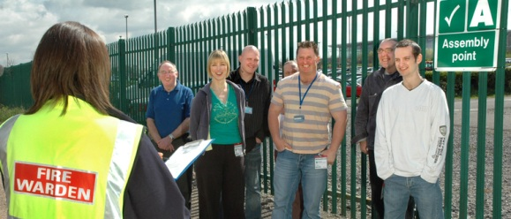
What you need to know
How to raise the alarm
The nearest exit route from your location
Location of Fire Alarm Call Points & Fire Extinguishers
Your Evacuation Procedure and Assembly Point
Your Fire Marshals or Wardens
Emergency telephone numbers
If you are unsure about any of the above, please discuss it with your line manager or contact the QSHE - Environmental and Fire Risk Compliance Service on 028 9047 5899 or email at EAEnvironmentalCompliance@eani.org.uk

Slide 25
Thank you for taking the time to complete this training
Please note that in order to register as having successfully completed this training, you MUST fill out and submit the ‘Confirmation of Training Completion – Basic Fire Safety Awareness Training Form’.
If you have any queries, please contact the QSHE - Environmental and Fire Risk Compliance Service on 028 9047 5899 or email at EAEnvironmentalCompliance@eani.org.uk

