Slide 1
Basic Asbestos Awareness Training
Last reviewed: January 2025

Slide 2
Learning Outcomes
At the end of this session staff should be able to:
Identify the properties of Asbestos
Gain an understanding of the statutory requirement to manage Asbestos
Identify the Education Authority (EA) management procedures that control the risks from Asbestos
Understand the Effects Asbestos can have on health
Recognise where Asbestos may be found in buildings
General procedures to be followed when Asbestos is disturbed

Slide 3
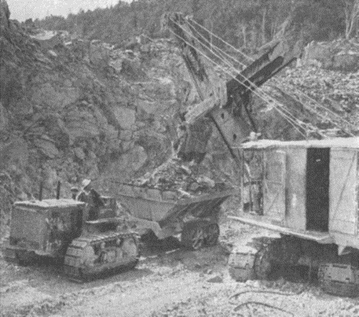
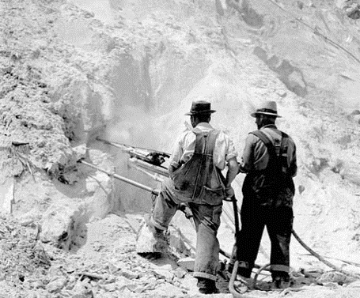
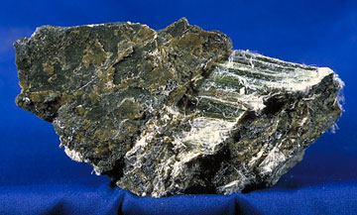
Asbestos
Asbestos is a naturally occurring mineral which is mined from the earth and can be broken down to extract fibres
Asbestos fibres are extremely durable, resistant to fire and most chemical reactions / breakdowns
These qualities were the reason for its popularity and use for many years
Asbestos was widely used in all areas of construction including commercial, industrial and domestic
Any material or article that contains Asbestos is known as an Asbestos Containing Material (ACM)
Asbestos is now strictly regulated, as exposure can be directly and scientifically linked to several lung and respiratory health conditions

Slide 4
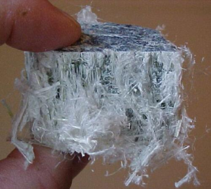
Asbestos Types
Chrysotile (White) Asbestos
Curled fibres
Part of the Serpentine group
Accounts for ~90% of Asbestos in situ
Is hydrophilic (can hold water)
Often a component of lower risk Asbestos products
While all Asbestos fibres can be harmful, chrysotile fibres present the lowest risk of the common Asbestos types

Slide 5
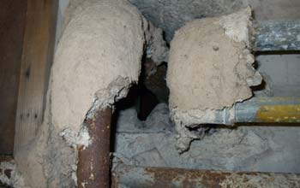
Asbestos Types
Amosite (Brown) Asbestos
Needle-like, barbed fibres
Part of the Amphibole Group
Hydrophobic (Resistant to water)
Primarily used in thermal insulation and Asbestos Insulating Board (AIB) products
Amosite fibres are considered more harmful than Chrysotile

Slide 6
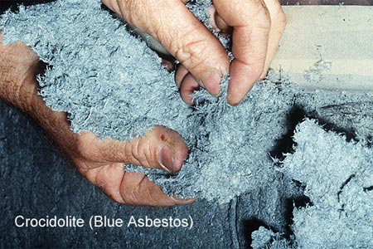
Asbestos Types
Crocidolite (Blue) Asbestos
Needle-like, barbed fibres
Part of the Amphibole Group
Hydrophobic (Resistant to water)
The least prevalent fibre type
Crocidolite is considered the most harmful of the common Asbestos types due to its characteristics

Slide 7
Asbestos Legislation & Guidance
The Legal Framework is laid out as follows:
The Control of Asbestos Regulations (Northern Ireland) 2012
Legislation
L143 Managing and Working with Asbestos
Approved Code of Practice
HSG227 A Comprehensive Guide to Managing Asbestos in Premises
HSG247 Asbestos: The Licensed Contractors Guide
HSG248 Asbestos: The Analysts Guide
HSG264 Asbestos: The Surveyors Guide
Sector Specific Guidance incl. Guidance for the Management of Asbestos in Schools
Health & Safety Guidance

Slide 8
Asbestos Duty Holder
The Control of Asbestos Regulations (Northern Ireland) 2012 introduces the role of Duty Holder
Duty Holder is defined as:
“every person who has, by virtue of a contract or tenancy, an obligation of any extent in relation to the maintenance or repair of non-domestic premises or any means of access or egress to or from those premises”

Slide 9
Duty Holder Responsibilities
Duty Holder is defined as those with an obligation of any extent in relation to the maintenance or repair of non-domestic premises
Duty holders must:
Familiarise themselves with the condition and location of ACMs within their premises.
Make information about ACMs in the building available to all staff and incorporate this information within the staff induction process.
Ensure all staff on site avoid disturbing ACMs during their routine daily activities.
Report any apparent change in the condition or circumstances of ACMs to EA QSHE Environmental and Fire Risk Compliance Service for further investigation - EAEnvironmentalCompliance@eani.org.uk
Ensure the Asbestos register is reviewed and signed by visitors and contractors who enter the premises if it is foreseeable that they may encounter Asbestos during their visit.

Slide 10
Duty to Manage
Regulation 4: Duty to Manage Asbestos in Non-Domestic Premises requires the Duty Holder to:
Make assessments to determine if Asbestos is present within buildings that were constructed before the year 2000
Determine the risks from Asbestos
Develop a Asbestos Management Plan showing how the organisation intends to manage the risks from Asbestos including policy and procedures
Monitor the condition of Asbestos containing materials

Slide 11
Duty to Manage
Ensure ACMs are properly managed
Ensure information about the location and condition of any Asbestos material is provided to every person liable to disturb it (including emergency services)
Review the plan at regular, defined intervals, and also if:
There is reason to suspect the Asbestos Management Plan is no longer valid; or
There is significant change in the premises to which the plan(s) relate
Ensure the policy and procedures detailed in the Asbestos Management Plan are implemented

Slide 12
Managing Asbestos
In order to comply with its legal obligations EA will:
Keep and maintain an up-to-date record of the location, condition, maintenance and removal of all ACMs in EA premises
Undertake remedial action to remove, repair or make safe Asbestos if there is a risk of exposure
Maintain Asbestos Containing Materials (ACMs) in a good state of repair and regularly monitor their condition
Ensure work undertaken on ACMs is carried out in accordance with legislation
Inform anyone who is liable to disturb ACMs about their condition and location
Provide information, instruction and training as appropriate
Have a written Asbestos Management Plan detailing organisational roles, responsibilities and procedures
Review the Asbestos Management Plan at regular intervals or if changes occur which impacts upon the suitability of the plan

Slide 13
Asbestos Surveys
An Asbestos Management Survey is a general, non-invasive investigation to determine the presence of any ACMs which may be encountered during normal occupancy or foreseeable maintenance activities
An Asbestos Reinspection Survey is to determine the up-to-date condition and risk posed by ACMs
An Asbestos Refurbishment Survey is an invasive investigation to determine the presence of ACMs which may be encountered during a specific refurbishment or maintenance task which will alter the fabric of the building
An Asbestos Demolition Survey: This survey is to determine all ACMs which may be disturbed when a building (or part of a building) is to be demolished

Slide 14
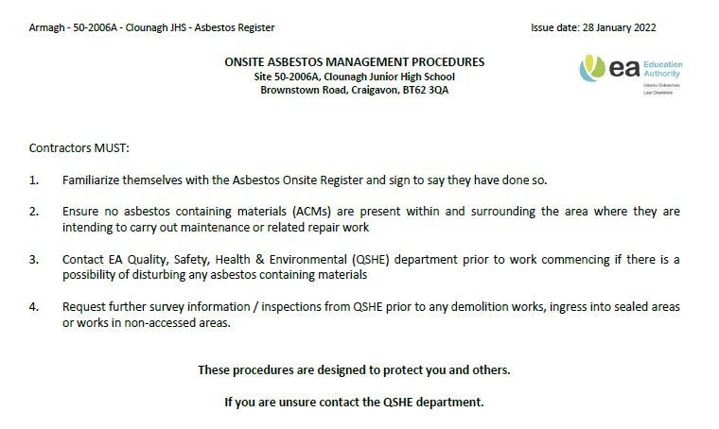
Asbestos Register
The Asbestos Register is a key document that ensures information about the location and condition of any Asbestos material is available to every person liable to disturb it
The following is an example of the standard EA Asbestos Register
Front Page
Provides instruction on how to use the Asbestos register.

Slide 15
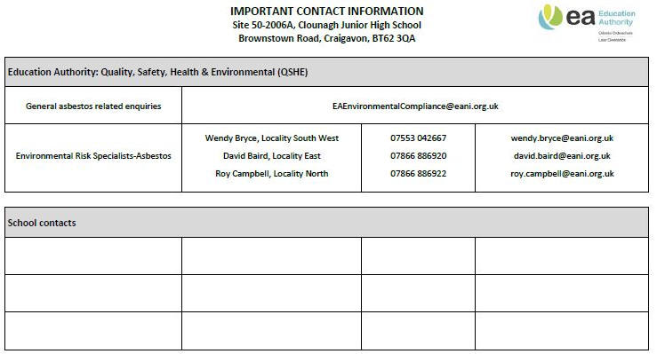
Asbestos Register
Contacts Page
This page will contain useful contact details for EA Asbestos Specialists & School Contacts

Slide 16
Asbestos Register
Contractor Signing In Record
This is a register of all contractors who have attended site and read the register - This procedure helps the EA fulfil our legal obligations
Any person visiting the property who may come in to contact with the ACMs at the site must be asked to read and sign the Asbestos Register

Slide 17
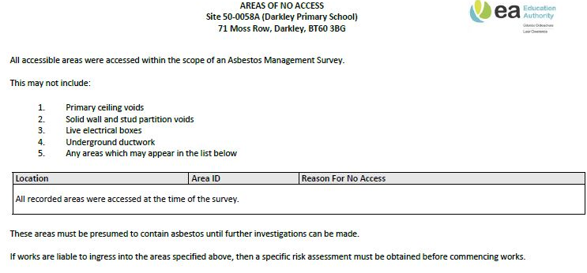
Asbestos Register
Areas of No Access
Any area that hasn’t been assessed for Asbestos MUST be presumed to contain Asbestos until proven otherwise. Areas that haven’t been accessed are listed here
Premises Name:

Slide 18
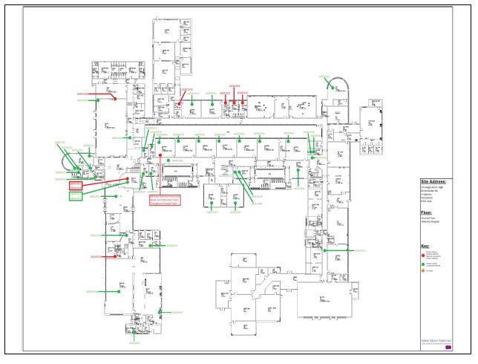
Asbestos Register
Floor Plans
The register will include floor plans showing the location of ACMs in the building

Slide 19
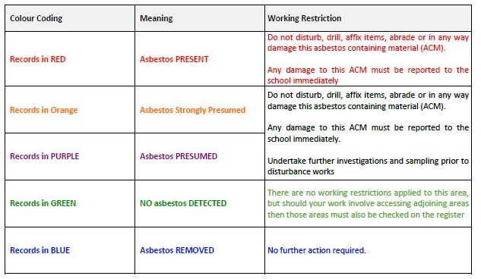
Asbestos Register
Asbestos Register Key
Records of Asbestos are logged on the Asbestos Register and colour coded

Slide 20
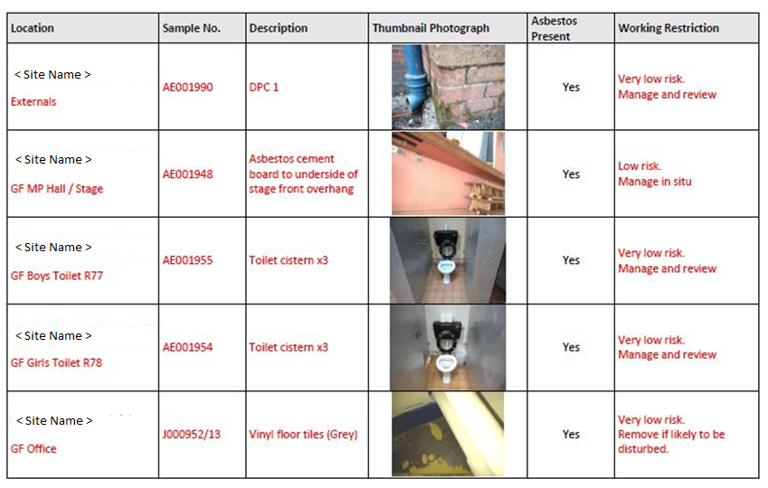
Asbestos Register
Asbestos Items
Each Asbestos item is listed and includes, where available, a photograph of the product type to assist with its identification

Slide 21
Effects on Health
Asbestos diseases are caused by breathing in very fine, microscopic fibres
As Asbestos accumulates in the lungs several types of respiratory diseases may occur:
Asbestosis
Mesothelioma
Lung Cancer
Pleural Thickening

Slide 22
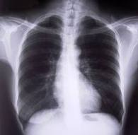
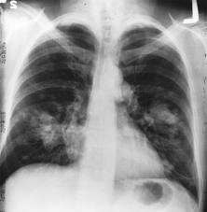
Asbestosis
Asbestosis is scarring of the lung tissue
Is caused by breathing in Asbestos over a period of many years
Resulting in lungs becoming less elastic causing progressive shortness of breath
Can be fatal
Symptoms are likely to appear approximately 15 to 20 years following exposure
Healthy lung
Lung showing Asbestosis

Slide 23
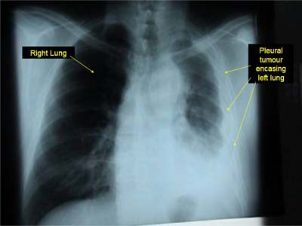
Mesothelioma
Mesothelioma is a cancer of the lining of the lungs (pleura) or more rarely the abdominal cavity (peritoneum)
Is caused by, almost exclusively, Asbestos exposure
Is almost always fatal
Symptoms are likely to appear approximately 35 to 40 years following exposure

Slide 24
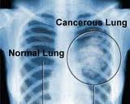
Lung Cancer
Lung Cancer is a malignant tumour of the lungs; this tumour can grow to affect surrounding tissue
Is caused by a range of factors, however the likelihood of developing lung cancer is increased if exposed to Asbestos
Smokers who are exposed to Asbestos are about 50–84 times more likely to develop Asbestos-related lung cancer
Avoidance of smoking can be beneficial to health and caution should always be taken to avoid unnecessary Asbestos exposure

Slide 25
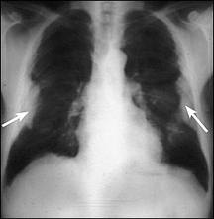
Pleural Thickening
Pleural Thickening is a non-malignant disease in which the lining of the lungs (pleura) become scarred
Pleural thickening typically causes discomfort but is generally non fatal

Slide 26
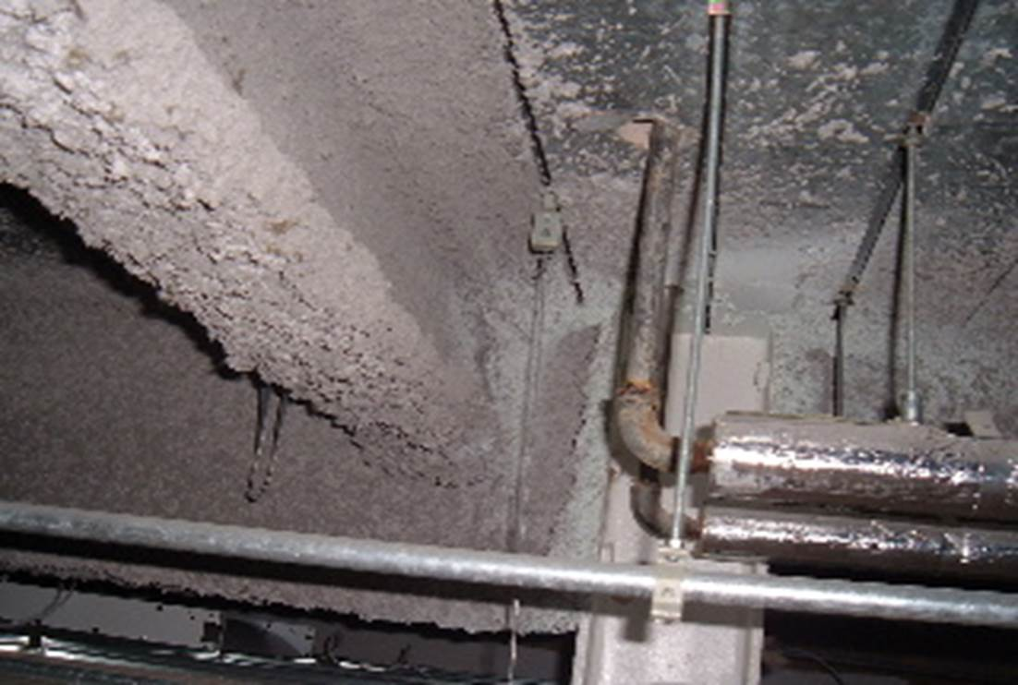
Example ACMs
Asbestos Sprayed Coating
Loose material with little bonding
Significant potential for airborne fibre release if disturbed
Primarily installed for fire protection

Slide 27
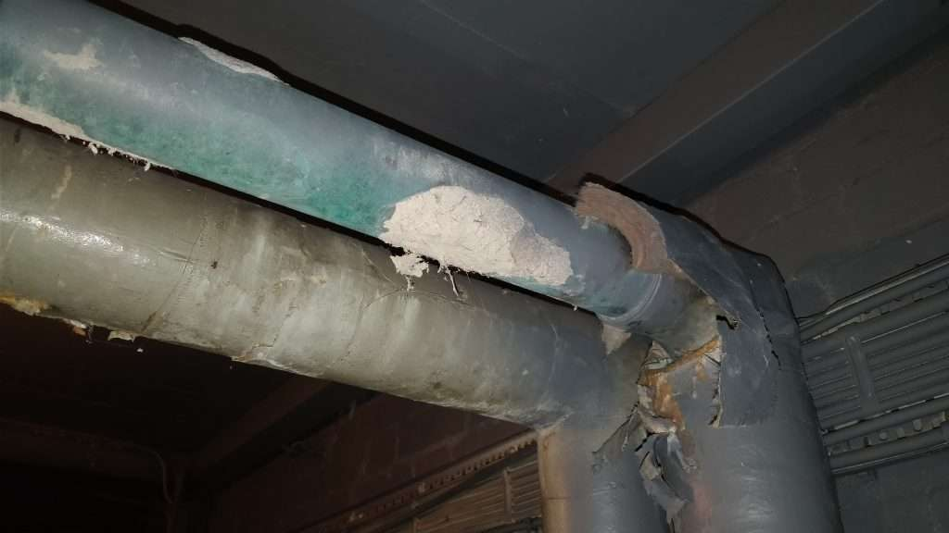
Example ACMs
Asbestos Lagging (Thermal Insulation)
Installations can include; hand applied or build up insulation, pre-formed sections, insulation slabs and blocks
Commonly found on pipework, calorifiers, vessels, tanks
Significant potential for airborne fibre release if disturbed
Primarily installed for heat insulation

Slide 28
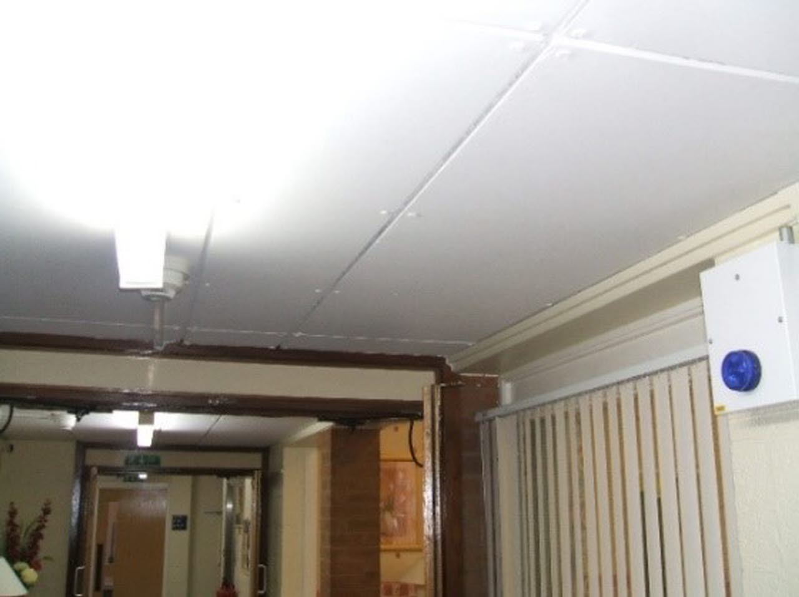
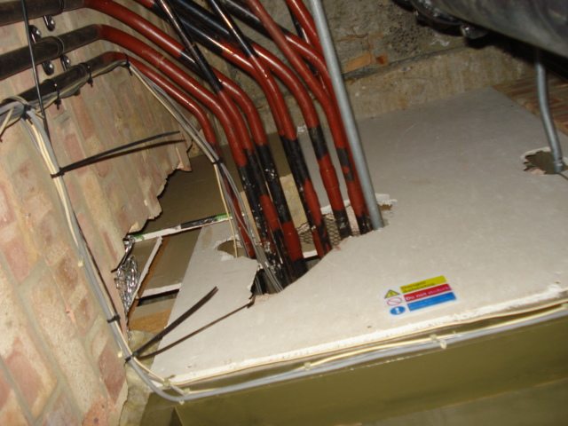
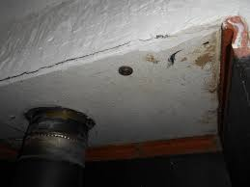
Example ACMs
Asbestos Insulating Board (AIB)
Widely used product
Common installations would be: ceiling materials, wall panelling, boxing or cladding, linings to / within fire doors, firebreaks etc
Significant potential for airborne fibre release if disturbed
Primarily installed for fire protection

Slide 29
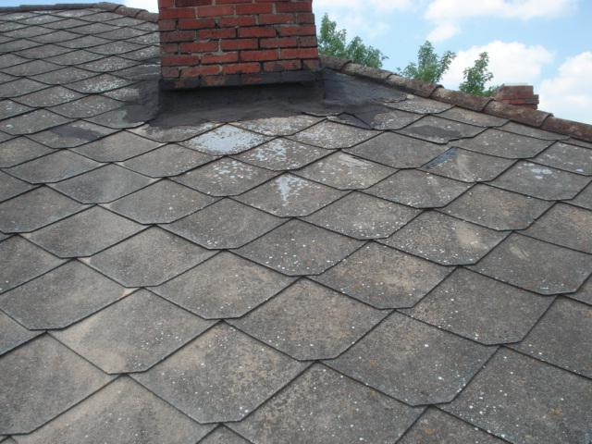
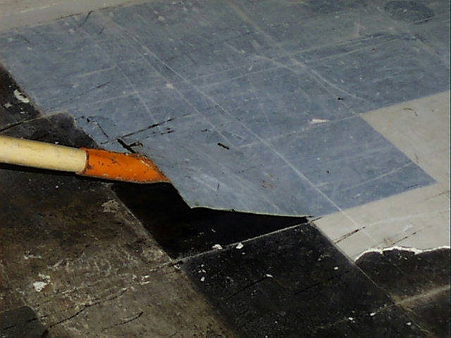
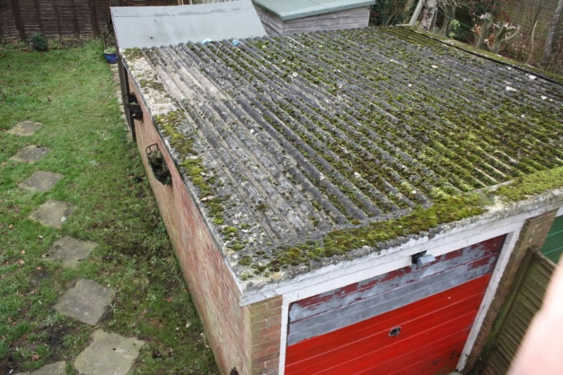
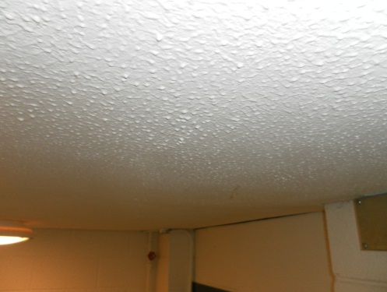
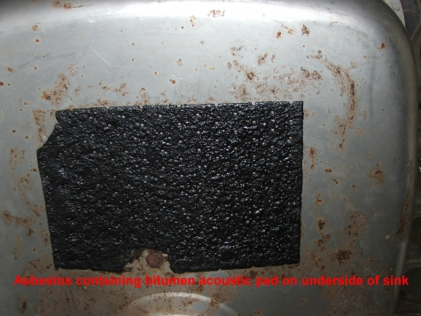
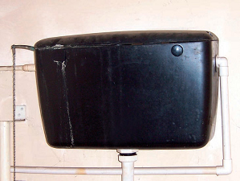
Example ACMs
Common materials considered to have a lower potential for fibre release:
Asbestos cement roof tiles
Asbestos vinyl floor tiles
Asbestos cement roof sheets
Textured coatings
Sink pads
Toilet cisterns

Slide 30
Disturbance of Asbestos
Where an employee and/or contractor encounters actual, presumed or suspected Asbestos in damaged condition they must:
Cease work and vacate the immediate vicinity
No attempt should be made to clean up dust, debris or to remove any tools or equipment from the area
Isolate the area where possible by closing doors / windows and using warning signage and tape
Isolate yourself from others
Contact your line manager who will:
Contact QSHE Environmental and Fire Risk Compliance Service for guidance and support: 028 9047 5899

Slide 31
Please Remember
This training does not qualify any person to work on ACMs
EA does not authorise employees to work on Asbestos products

Slide 32
Useful Links
The Control of Asbestos Regulations (Northern Ireland) 2012 - legislation.gov.uk(external link opens in a new window / tab)
The Hazardous Waste Regulations (Northern Ireland) 2005 - legislation.gov.uk
https://www.hseni.gov.uk/publications/l143-managing-and-working-Asbestos-gb-acop-approved-use-ni
https://www.hse.gov.uk/pubns/books/hsg227.htm
http://www.hse.gov.uk/Asbestos/index.htm
https://www.hseni.gov.uk/
https://www.hseni.gov.uk/publications/managing-Asbestos-schools-within-northern-ireland

Slide 33
End of Presentation
Thank you for taking the time to complete this training
Please note that in order to register as having successfully completed this training, you MUST fill out and submit the ‘Confirmation of Training Completion – Basic Asbestos Awareness Training Form’.
If you have any queries, please contact the QSHE - Environmental and Fire Risk Compliance Service on 028 9047 5899 or email at EAEnvironmentalCompliance@eani.org.uk

